Slide 1


DWH PROJECT
ETL (SSIS) Package && SSAS
Under Supervisior ENG: Hazzam Omar
Abdullah Ibrahim Mahmoud

Slide 2

TOPICS
INTRO
Prepare Data Sources
ETL Package
SSRS (CUBES )
Final tables in DWH
CODING
Final star schema
- - - - - - - - - - - - - - - - - - - - - - -
- - - - - - - - - - - - - - - - - - - - - - -

Slide 3
Introduction
create DWH in SQL server and then Implement an SSIS package solution to perform ETL to the "DW" server.
In My package contain full parameter like control flow , data flow and etc .DWH consists of the fact table to describe the aggregate function and number of dimensions to follow the describe it
AND THEN DOING Some tasks at SSAS(CUBES)

Slide 4
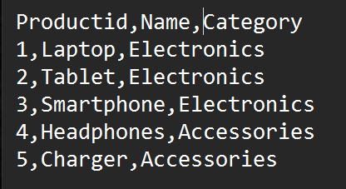
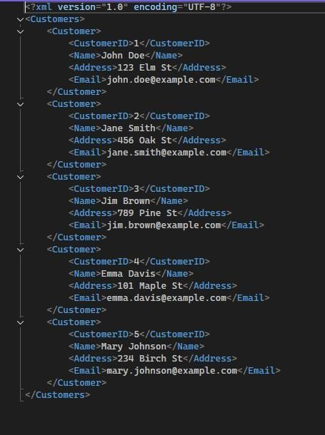
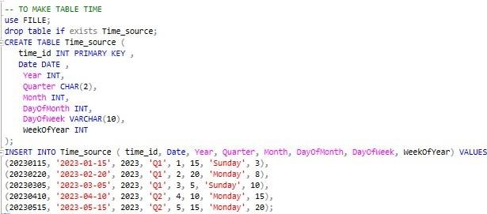
Prepare Data Sources
1. Text File (products.txt)
3. XML File (customers.xml)
2. Database Dump (orders.sql)

Slide 5
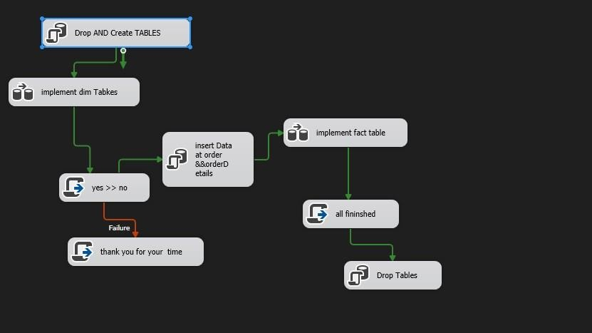
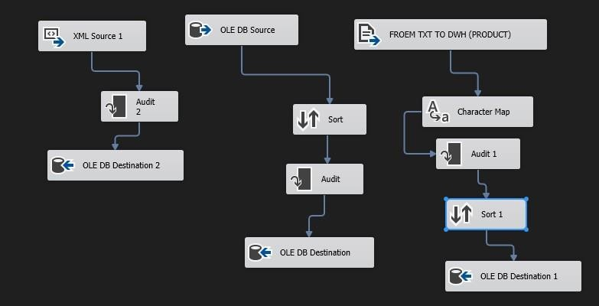
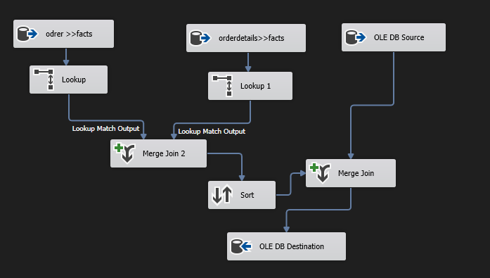
ETL Package
This photo
contain full parameter like control flow , data flow and etc
This photo
contain data flow one is Specialized at implement dimensions table
This photo
contain data flow two is Specialized at implement Fact table
I 4

Slide 6
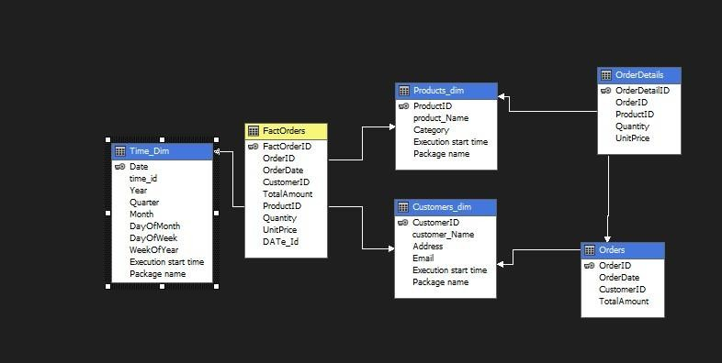
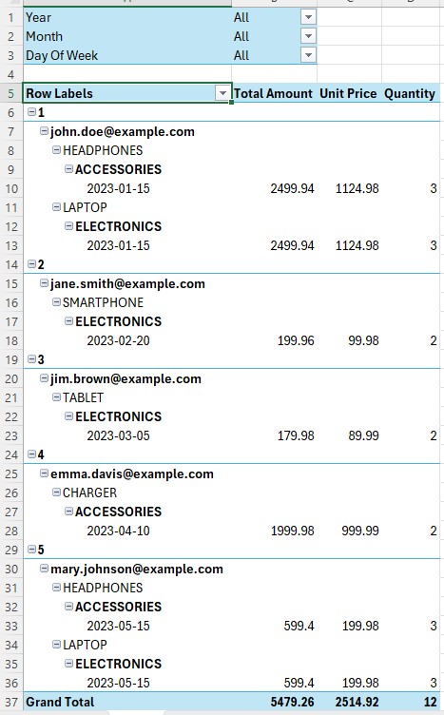
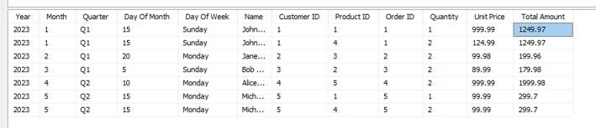
SSRS (Cubes)
This final cubes In Excel
This photo Contain cubes In SSRS
This photo contain some analysis in Cube

Slide 7
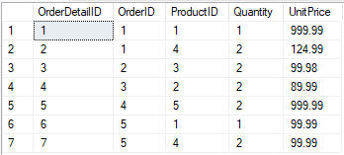
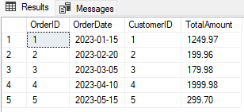
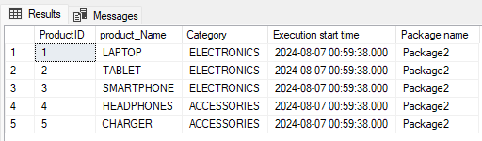
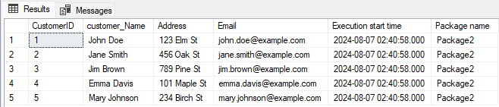
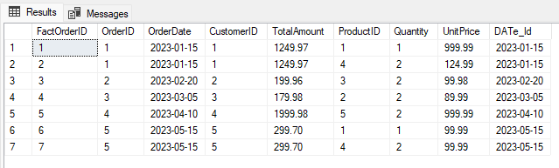
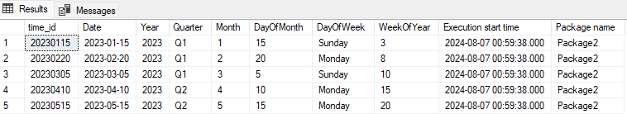
Final tables in DWH
OrderDetails
Orders
Products_Dim
Customers_Dim
Fact_Table
Time_Dim

Slide 8
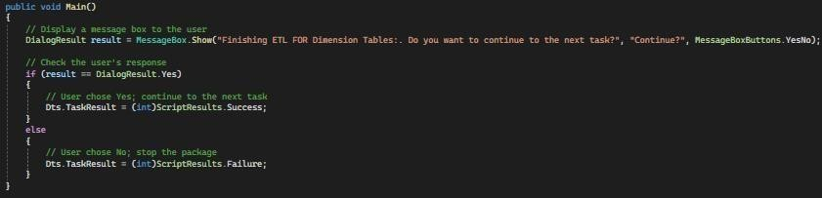


CODING
First C#

Slide 9
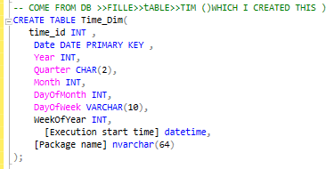
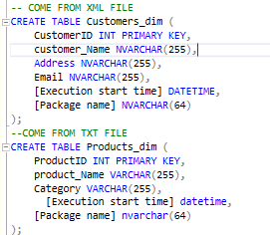
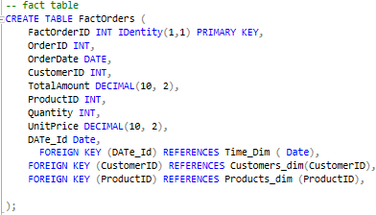
CODING
Second SQL

Slide 10
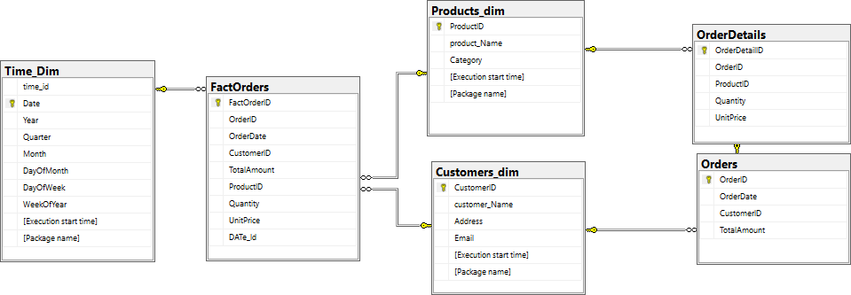


Final schema

